Slide 1


Social Buzz
Data Analysis

Slide 2


Today's agenda
Project recap
Problem
The Analytics team
Process
Insights
Summary

Slide 3


Social Buzz is a fast growing technology unicorn that needs to adapt quickly to its global scale. Accenture has begun a 3 month POC focusing on these tasks
Audit of big data practice
Recommendations for a successful IPO
Analysis to find Social Buzz’s top 5 most popular categories of content.
Project Recap

Slide 4


Problem
Over 100,000 posts per day
36,500,000 pieces of contents per year
But how to capitalize on it when there is so much?
Analysis to find Social Buzz’s top 5 most popular categories of content

Slide 5



Andrew Fleming
Chief Technology Architect
The Analytics team
Marcus Rompton
Senior Principal
Quadri Usman
Data Analyst

Slide 6

Process
1
Data Understanding
2
Data Cleaning
3
Data Modelling
4
Data Analysis
5
Uncover Insights

Slide 7


Insights
16
UNIQUE
CATEGORIES
1897
REACTIONS TO ANIMAL POSTS
JANUARY
MONTH WITH MOST POSTS

Slide 8
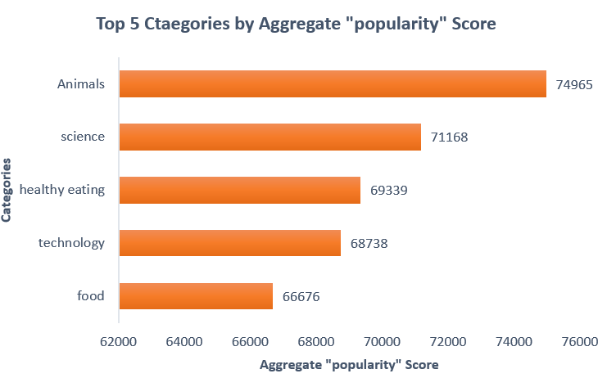

Slide 9
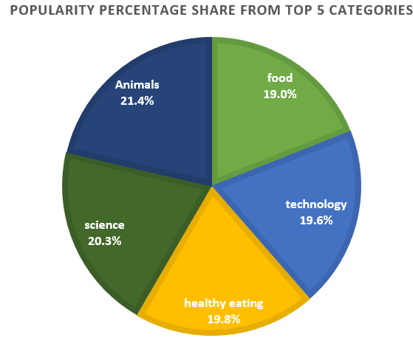

Slide 10


ANALYSIS
Animals and science are the two most popular categories of content, showing that people enjoy “real-life” and “factual” content the most.
INSIGHT
Food is a common theme with the top 5 categories with “Healthy Eating” ranking the highest. This may give the indication to the audience within your user base. You could use this insight to create a campaign and work with healthy eating brands to boost user engagement.
NEXT STEP
The ad-hoc analysis is insightful. But it’s time to take the analysis into large scale production for real-time understanding of your business. We can show you how to do this.
Summary

Slide 11

Thank you!
ANY QUESTIONS?

